Slide 1

Converting to .NET Core
Matt Watson
Founder & CEO, Stackify

Slide 2





































TITANIUM SPONSORS
Platinum Sponsors
Gold Sponsors

Slide 3

Agenda
Why are we doing this?
Migrating to xproj and project.json
Understanding framework targeting
What works and doesn’t work
Converting a simple class library
How we converted Prefix to .NET Core
© Stackify, 2016

Slide 4
Why are we doing this?
ASP.NET & IIS are a little bloated
ASP.NET Core is lean and mean
Developers like Owin, NodeJS and other simple web servers
Kestrel is designed for pure speed
Microsoft wants to be relevant on Linux*
*As long as it is hosted on Azure
© Stackify, 2016

Slide 5

.NET on LINUX!?!?
© Stackify, 2016

Slide 6
Goodbye csproj, hello xproj
Core uses xproj
By default shows all files in your folder
Project.json is the heart of your config
Multi framework and platform targeting
© Stackify, 2016

Slide 7
Demo: Converting to project.json and xproj
© Stackify, 2016

Slide 8
Goodbye xproj, hello csproj v2… ????
xproj and project json is being replaced in Visual Studio 15??
Long live csproj v2!
© Stackify, 2016

Slide 9
Targeting
Multiple framework targeting is easy and… confusing
Frameworks
Pick 1 to many
Net45
netstandard1.0-1.6
netcoreapp1.0
Dependencies
Framework Assemblies
Runtimes (RIDs)
Windows
OSX
Linux
© Stackify, 2016

Slide 10
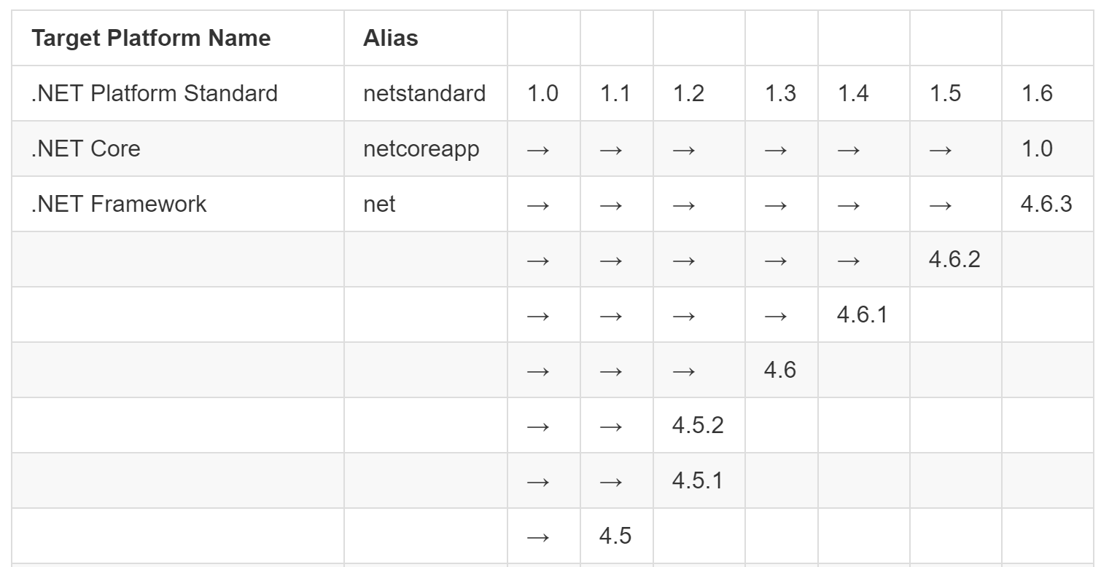
Introducing NetStandard
© Stackify, 2016

Slide 11
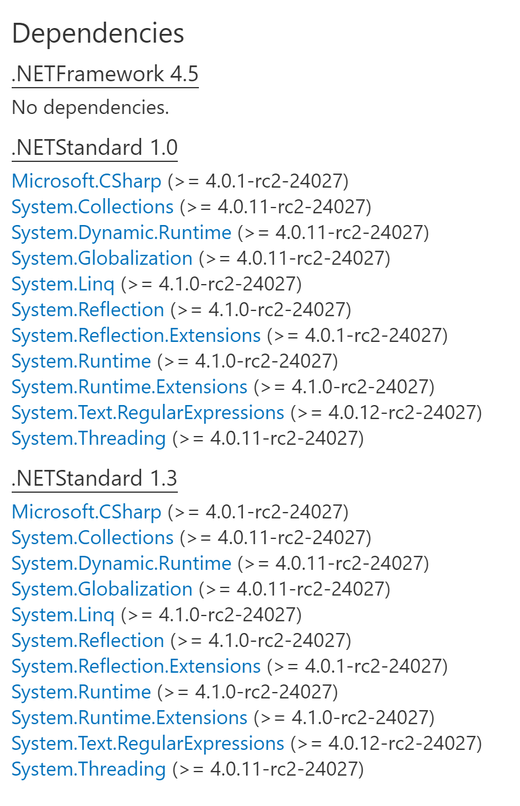
Example: Serilog on nuget
© Stackify, 2016

Slide 12
What doesn’t work in .NET Core?
Third party libraries!!!
Windows “stuff”
Registry
WMI
Other land mines
Not in Core:
DataSet/DataTable
System.Drawing
System.Web
Things have been rearranged
FileStream is in System.IO.FileSystem
Some methods have changed
New StreamReader(“c:\file.txt”) doesn’t work
Reflection APIs
© Stackify, 2016

Slide 13
Are you “hard core”?
What platform(s) do you want to run your app on?
Do you really need the full core experience??? Are you hard core?!?!
Windows
Linux
Mac OSX
You can use .NET Core on Windows with .NET 4.5 and use all your existing libraries!
© Stackify, 2016

Slide 14
Converting StackifyLib to Core
What is StackifyLib?
Used to report metrics, exceptions, and logs to Stackify
Was targeting .NET 4.0
Basic class library project
Now targets NETStandard1.3 and NET40
Using #if compiler directives to support both in same codebase
© Stackify, 2016

Slide 15
DEMO: StackifyLib code
© Stackify, 2016

Slide 16
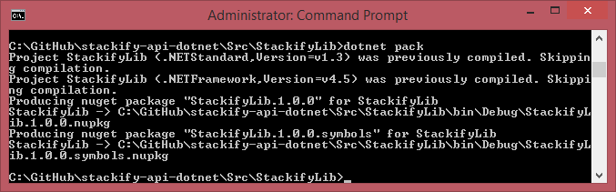
Easy packages!
© Stackify, 2016

Slide 17
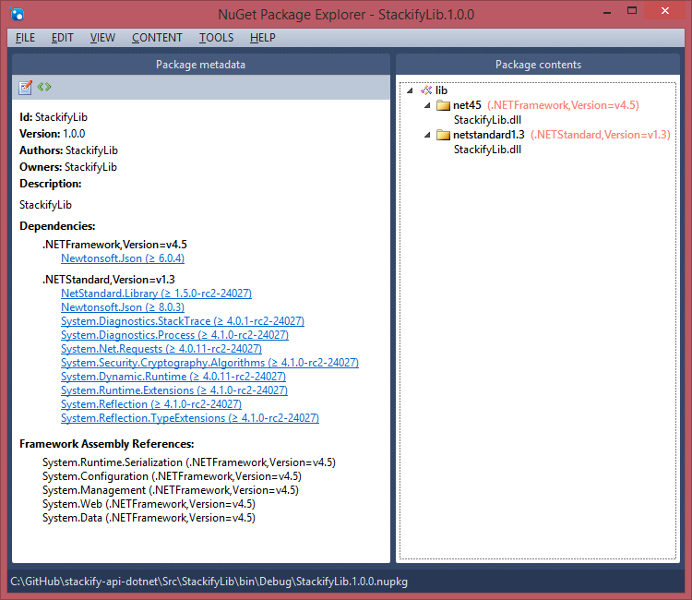
© Stackify, 2016

Slide 18
Converting Prefix to Core
What is Prefix?
Tracks local web requests and shows them to developers. Supports .NET & Java on Windows.
Was targeting .NET 4.5
Self hosted Web API project runs as a Windows Service
Has shared libraries with 2 other apps
Uses a third party SQL parsing library
GOAL: Support Java on Mac, later .NET on Mac
© Stackify, 2016

Slide 19
Getting organized
Split all Windows specific code to their own projects
Code to configuring .NET profiler
.NET 4.5 dependent SQL Parser
IIS related code
Other Windows stuff
Create new .NET Core Kestrel app that uses shared libraries
Use some compiler directives in shared libraries for little differences
© Stackify, 2016

Slide 20
Challenge #1
Goodbye log4net, hello Serilog!
Log4net doesn’t work (yet) for Core
© Stackify, 2016

Slide 21
Challenge #2
Use same Controller classes for MVC6 and Web API, converting Web API HttpResponseMessage to work with MVC6
© Stackify, 2016

Slide 22
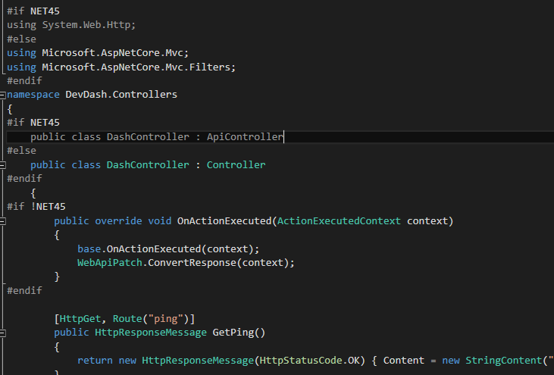
© Stackify, 2016

Slide 23
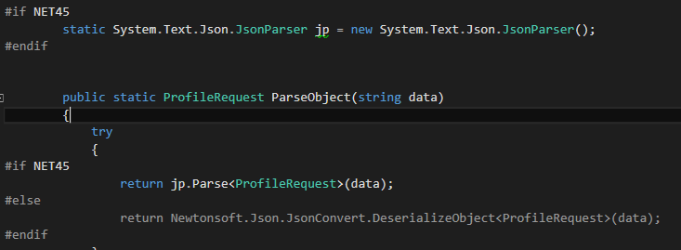
Challenge #3
Using two different JSON parsers
© Stackify, 2016

Slide 24
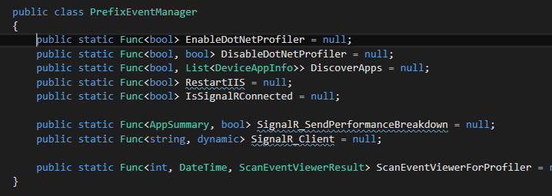
Challenge #4
Allowing different logic between the apps, some due to NET45 vs Core, but also due to Windows vs Mac
© Stackify, 2016

Slide 25
Demo: Prefix & Code
© Stackify, 2016

Slide 26
Notes
Find classes in .NET Core
http://packagesearch.azurewebsites.net/
Chat with ASP.NET Core team and community on Slack
https://aspnetcore.slack.com/
Convert packages.config to project.json
https://github.com/wgtmpeters/nugetprojectjson
© Stackify, 2016

Slide 27
Questions?

